Slide 1

Chapter 4: Project Integration Management
Information Technology Project Management, Seventh Edition

Slide 2
Learning Objectives
Describe an overall framework for project integration management as it relates to the other project management knowledge areas and the project life cycle
Discuss the strategic planning process and apply different project selection methods. (Done in last weeks lecture business case, others the students can read
Explain the importance of creating a project charter to formally initiate projects. (already done in last weeks lecture)
Describe project management plan (already done in last week’s lecture.

Slide 3
Learning Objectives
Explain project execution, its relationship to project planning, the factors related to successful results, and tools and techniques to assist in directing and managing project work
Describe the process of monitoring and controlling a project
Understand the integrated change control process, planning for and managing changes on information technology (IT) projects, and developing and using a change control system
Explain the importance of developing and following good procedures for closing phases/projects

Slide 4
What is Project Integration Management
Coordinating the other project management knowledge areas (project management processes/tasks) throughout a projects life cycle.
Ensures that all elements of a project come together at the right times to complete a project successfully

Slide 5
Project Integration Management Processes
1. Developing the project charter involves working with stakeholders to create the document that formally authorizes a project—the charter.
2. Developing the project management plan (creating a project proposal) involves coordinating all planning efforts to create a consistent, coherent document—the project management plan (various plans/documents- 9 knowledge Areas)
3. Directing and managing project work involves carrying out (executing) the project management plan by performing the activities included in it.

Slide 6
Project Integration Management Processes (cont’d)
Monitoring and controlling project work involves overseeing activities to meet the performance objectives of the project
Performing integrated change (part of monitor/ control) control involves identifying, evaluating, and managing changes throughout the project life cycle.
Closing the project or phase involves finalizing all activities to formally close the project or phase.

Slide 7
Why Project Integration Management (PIM)?
PIM is considered to be critical to overall project success
PIM enables project managers to:
coordinate people, plans and work required to complete a project
focus on the big picture of the project and steer the project team towards successful completion
make swift decisions or empower someone in the team to make swift decisions (first time right decisions) when conflicts occur among project goals or people
communicate key project information to top management
effectively manage interface with stakeholders (provide stakeholder satisfaction)
PM must establish and maintain good communication/relationship across organisation.
PIM must happen within the context of the entire organisation, not just within a project
PM must integrate the work of project with ongoing operations of the organisation
PIM- is project management based on 9 knowledge areas
PIM is what gets performed in projects to deliver the projects successfully

Slide 8
Strategic Planning and Project Selection
What project to pursue?
Should PMs be involved in decision making?
Usually it is the top management responsibility
Successful organisation know PMs can provide important information to help identify and select potential projects
PMs, Product Managers or IT managers must take part in Strategic Planning

Slide 9
Strategic Planning and Project Selection
Strategic planning involves determining long-term objectives, predicting future trends, and projecting the need for new products and services
Organizations often perform a SWOT analysis
analyzing Strengths, Weaknesses, Opportunities, and Threats
As part of strategic planning, organizations
identify potential projects
use realistic methods to select which projects to work on
formalize project initiation by issuing a project charter

Slide 10
Methods for Selecting Projects
There are usually more projects than available time and resources to implement them
Methods for selecting projects include: (underlined bits- students can read from the text book)
focusing on broad organizational needs
categorizing information technology projects
performing net present value or other financial analyses (business case)
using a weighted scoring model (next lecture slide)
implementing a balanced scorecard

Slide 11
5. Weighted Scoring Model
A weighted scoring model is a tool that provides a systematic process for selecting projects based on many criteria
Identify criteria important to the project selection process
Assign weights (percentages) to each criterion so they add up to 100%
Assign scores (out of 100) to each criterion for each project
Multiply the scores by the weights and get the total (add) weighted scores
The higher the weighted score, the better (get higher priority)

Slide 12
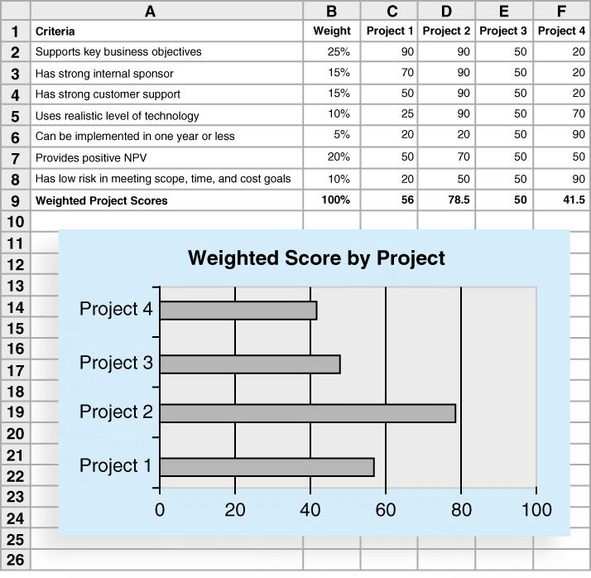
Figure 4-7. Sample Weighted Scoring Model for Project Selection

Slide 13
Developing a Project Management Plan
A project management plan is a document used to coordinate all project planning documents and help guide a project’s execution and control
Plans created in the other knowledge areas are critical part of project management plan
i.e. plans and documents based on the other 9 knowledge areas are developed
→Project management plan (PMI knowledge area)

Slide 14
Common Elements of a Project Management Plan
1. Introduction or overview of the project
Project name, brief description of the project and the need it address (goals and reason for it), rough estimates (time & cost);
names of project manager (contact for project information) & key team members;
Deliverables of the project (project phase deliverables, software, hardware, technical report, training report)
List of reference material (reference and summarize the plans produced for other knowledge areas)
List of definitions (help to avoid confusion)
2. Description of how the project is organized
Organisational charts (sponsor)
Project responsibilities (identify project activities and people responsible for them)
Document any major processes to follow on projects

Slide 15
Common Elements of a Project Management Plan
3. Management and technical processes used on the project:
Management objectives; management view, any major assumptions or constraint
Project controls; how to monitor project progress (monthly or quarterly reviews); handle changes-what is the process for change control, level of management required to approve different types of changes.
Risk/Issue management; how the team will identify, manage and control risks/issues
Project staffing; number and types of people required on project
Technical processes; describes specific methodologies a project might use

Slide 16
Common Elements of a Project Management Plan
4. Work to be done,
Major work packages – summarize the main work packages (Work Breakdown Structure - WBS) for the project and refer to appropriate sections of the scope management plan
Other work related information – list hardware and software to be used on the project
5. Schedule information
Provide a summary overall project schedule (key deliverables and planned completion dates)
Detailed schedule; provide more detailed information about project schedule. It should reference the schedule management plan and discuss dependencies among project activities that could affect project activities (network diagram, critical path)
6. Budget information
Summary budget
Detailed budget

Slide 17
Project Management Plan (PMP)
Produce various plans& documents (we will learn them through other 9 knowledge areas)
These plans & documents will be used to write (justify and support) the sections 1 to 6 shown in the template for PMP
Most sections of the PMP require providing summary based from the plans & documents, the actual plans & documentation must be provided in appendix of the PMP
PMP is the proposal for undertaking the project which needs approval from the management before you can embark on the actual project work
Next year for R & D project paper your team will be required to do PMP
Present to get approval
Do the necessary changes
Then only your team will be allowed to carry out the project- work will be based on PMP

Slide 18
Directing and Managing Project Work (Execution of PMP)
Involves managing and performing the work described in the project management plan
The majority of time and money is usually spent on execution
The application area of the project directly affects project execution because the products of the project are produced during execution

Slide 19
Coordinating Planning and Execution
Project planning and execution are intertwined and inseparable activities
Those who will do the work should help to plan the work
Project managers must solicit input from the team to develop realistic plans

Slide 20
Project Execution Tools and Techniques
Expert judgment: Experts can help project managers and their teams make many decisions related to project execution
Meetings: Meetings allow people to develop relationships, pick up on important body language or tone of voice, and have a dialogue to help resolve problems.

Slide 21
Monitoring and Controlling Project Work (including change management)
Changes are inevitable on most projects, so it’s important to develop and follow a process to monitor and control changes (change management plan in PMP)
Monitoring project work includes collecting, measuring, and disseminating performance information
A baseline is the approved project management plan plus approved changes

Slide 22
Performing Integrated Change Control
Three main objectives are:
Influencing the factors that create changes to ensure that changes are beneficial
Determining that a change has occurred
Managing actual changes as they occur

Slide 23
Change Control System
A change control system is a formal, documented process that describes when and how official project documents and work may be changed
Describes who is authorized to make changes and how to make them

Slide 24
Closing Projects or Phases
To close a project or phase, you must finalize all activities and transfer the completed or cancelled work to the appropriate people
Main outputs include
Final product, service, or result transition
Organizational process asset updates

Slide 25
Chapter Summary
Project integration management involves coordinating all of the other knowledge areas throughout a project’s life cycle
Main processes include
Develop the project charter
Develop the project management plan
Direct and manage project execution
Monitor and control project work
Perform integrated change control
Close the project or phase

